Slide 1
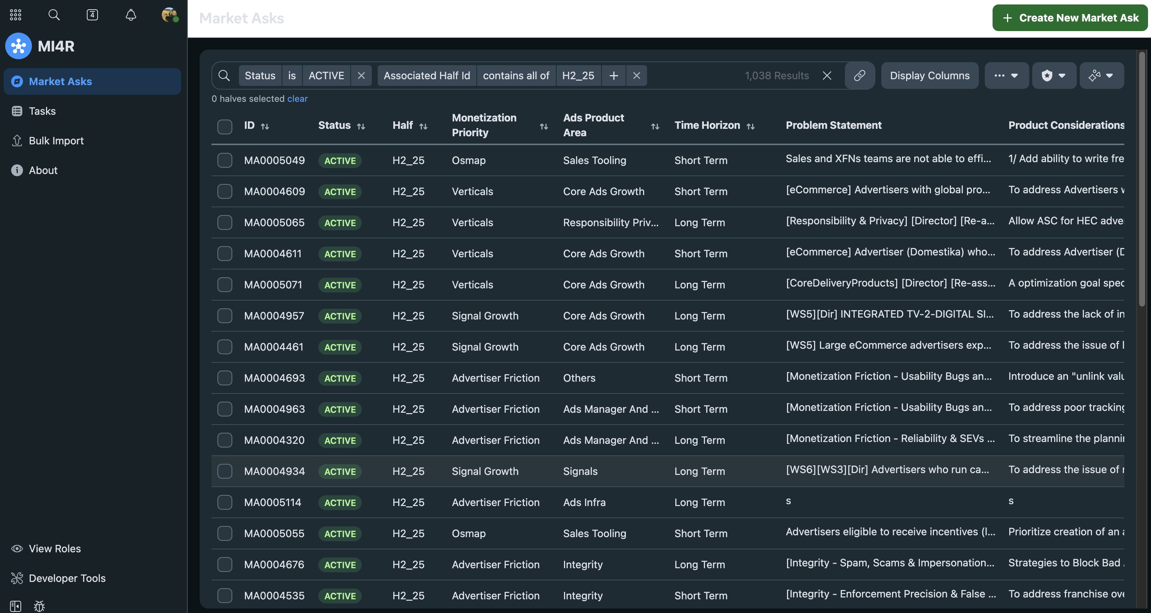
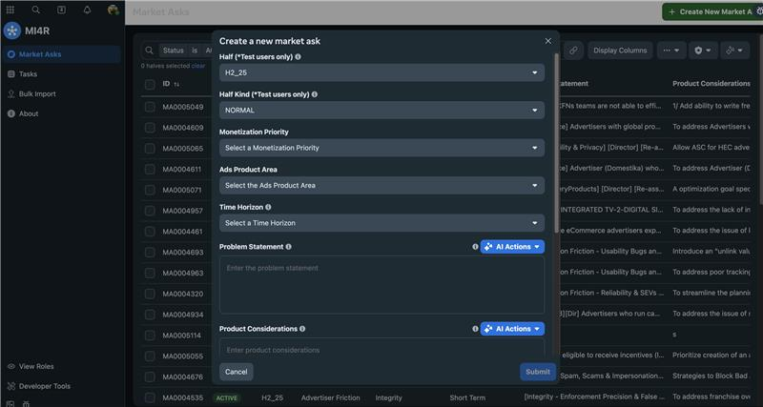
Market Insights for Roadmapping (MI4R)
MetaGen AI
MetaMate AI
Intern Notifications
Intern Activities
Custom tasking system
Integrations &
Technology
The Business Need
Meta’s Global Business & Product Marketing team previously relied on Google Sheets for gathering market insights, leading to inefficiencies in search, submission, and reporting.
What We Did
Affirma developed a custom Intern Application to replace Google Sheets with a more efficient, structured system. Key features:
Custom Tasking System – Integrated with notifications for task actions such as creation, resolution, and reassignment.
Bulk Actions – Merging, notifying, editing, and carrying over market asks across planning periods.
AI Integration – Implemented MetaGen AI and MetaMate AI for enhancement, summarization & merging of insights.
Enhanced Collaboration – Commenting system with @mentions, version history, and activity tracking.
Advanced Search & Filtering – Dynamic search, including recursive employee-based queries and empty field filtering.
Admin Controls – Tools for managing planning periods, permissions, and bulk uploads via a robust CSV importer.

Slide 2
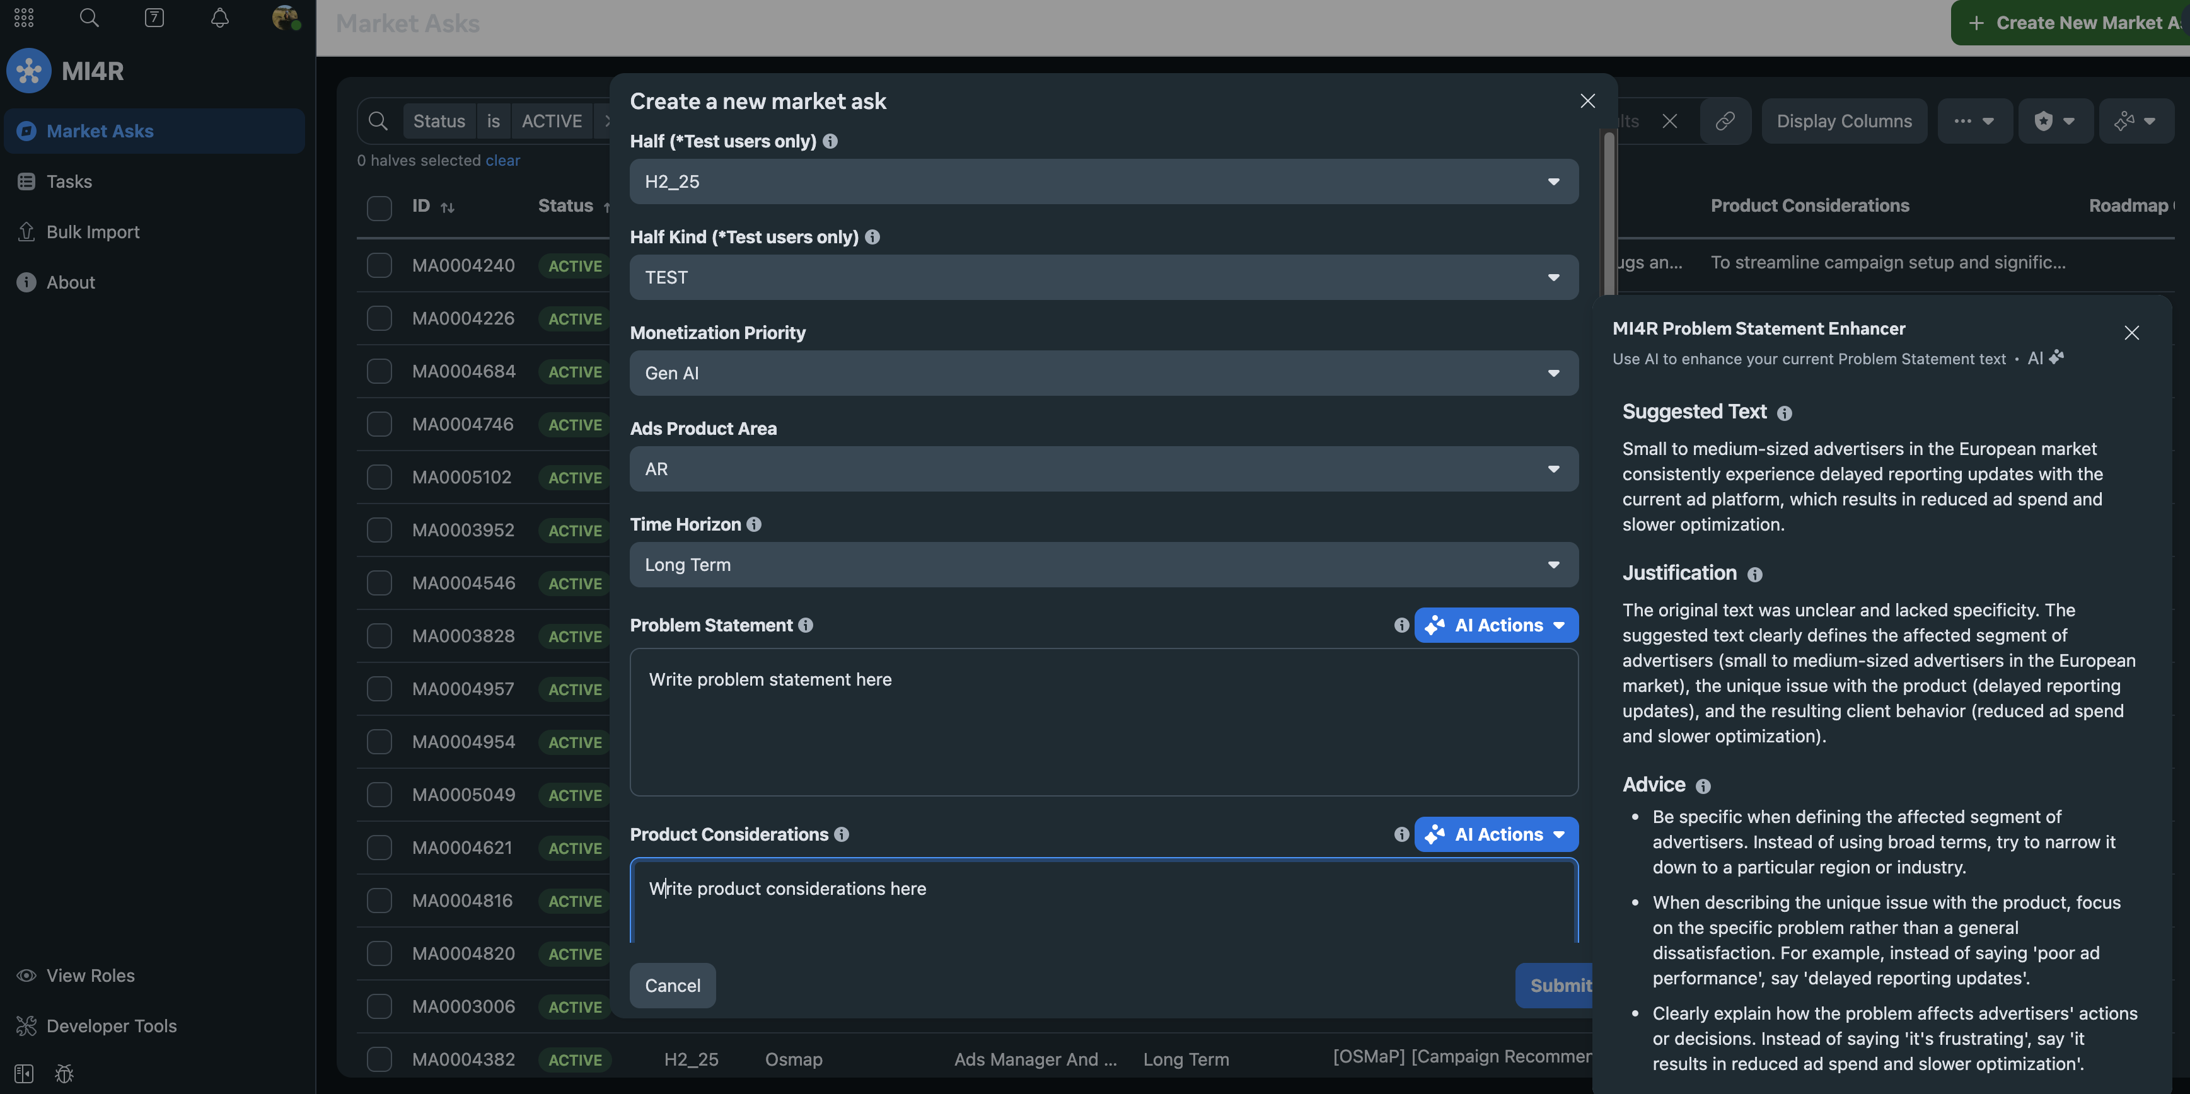
Market Insights for Roadmapping (MI4R)
REQUEST FORM
WITH AI

Slide 3
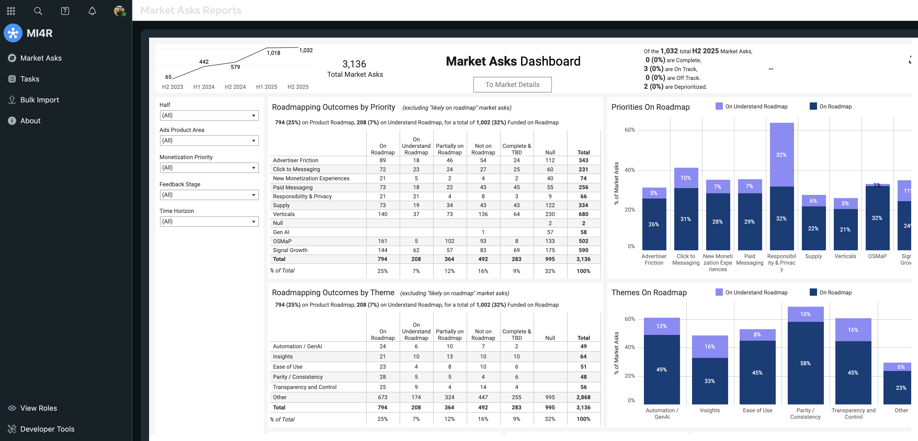
Market Insights for Roadmapping (MI4R)
REPORTING DASHBOARD

Slide 4
Market Insights for Roadmapping (MI4R)
FEATURES IN DEVELOPMENT
Ongoing Support
Affirma is actively expanding the MI4R tool’s capabilities with new features, while providing continuous engineering support.
Next Phase of Development
Process Tracking – Measuring de-duplication effectiveness and insight quality trends over time.
UI/UX Enhancements – Improved navigation, tooltips, and field behavior refinements.
Dynamic Configuration – Admin controls for customizing fields, dropdown options, and metadata.
Role-Based Access – User-submitted access requests and admin-managed permissions.

